Slide 1
CARETAKER SITE PRESENTATION
July 15th, 2020

Slide 2
Caretaker Site Presentation July 15th, 2020

Slide 3
Caretaker Site Task Force Considerations:
Maintain the Cottage for community use including rental
Sell the Cottage which requires a sale of some of the existing club property
Demolish the Cottage (fully or partially) and maintain the vacant property for club use
Key Findings After Community Engagement Process:
Community members very much like the idea of a community hub
Most view caretaker property as not a suitable site for the community hub
A common desire not to raise Club fees
Caretaker Site Presentation July 15th, 2020

Slide 4
Over 89% of survey respondents agree that a community hub is very or somewhat important for community programs and activities
Caretaker Site Presentation July 15th, 2020

Slide 5
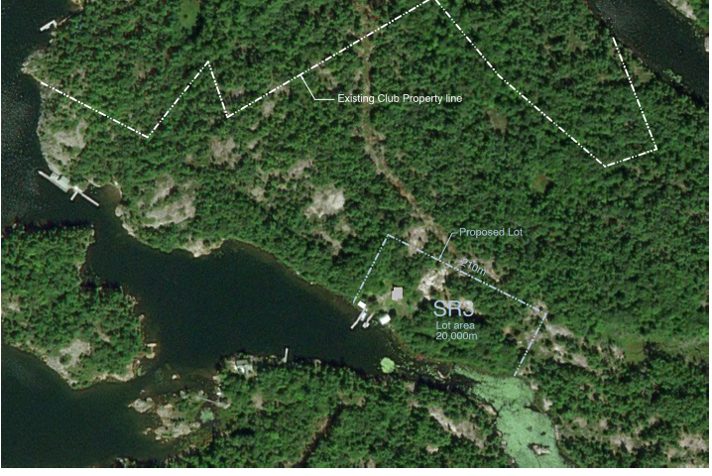
I - SALES OPTIONS
The Caretaker/Regatta Site currently measures 53 acres
Improvements consist of the Cottage, Store, Workshop, Shed and a dock
Potential severed lot size could be 3.5 acres starting 5 M west of the store to include 210 M of shoreline
Full land parcel survey and rezoning required and an Official Plan Amendment
Caretaker Site Presentation July 15th, 2020

Slide 6
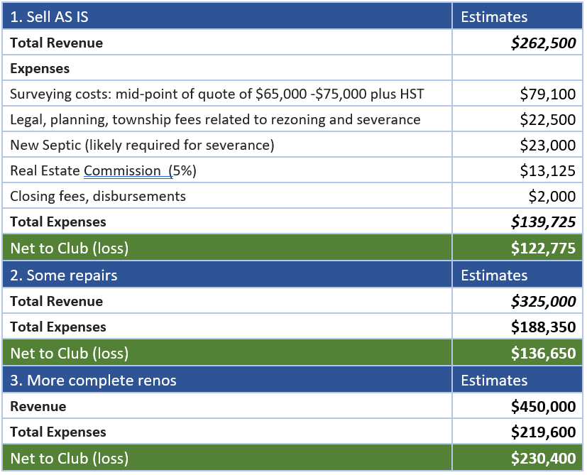
I - SALES OPTIONS con’d
Option 1: “As-is”- no repairs to house save for site work, pruning of trees
Option 2: “Some Repairs” – replacing deck and back stairs, removing carpets and replace with wood flooring, repairing drywall and painting walls
Option 3: “More Complete Renos” – replacing water system, replacing some windows and a kitchen renovation
Caretaker Site Presentation July 15th, 2020

Slide 7
I - SALES OPTIONS con’d
PROS
Option 1 is the simplest, fastest and carries the least financial exposure
Selling “as-is” also makes economic sense as there is a strong likelihood that a buyer will opt to tear down the cottage and build a new one
Option 3 offers potentially a substantially larger return on investment
Selling the site raises some funding for potential improvements for a community hub elsewhere (e.g. Main Dock)
CONS
Loss of a club asset and the future potential to develop or repair a club-owned residential or commercial site
Loss of the Regatta Party site, in particular its large, flat, readily accessible surfaces
Need to recut trails for a contiguous link to the Main Land Trail system from the Main Dock
Caretaker Site Presentation July 15th, 2020

Slide 8
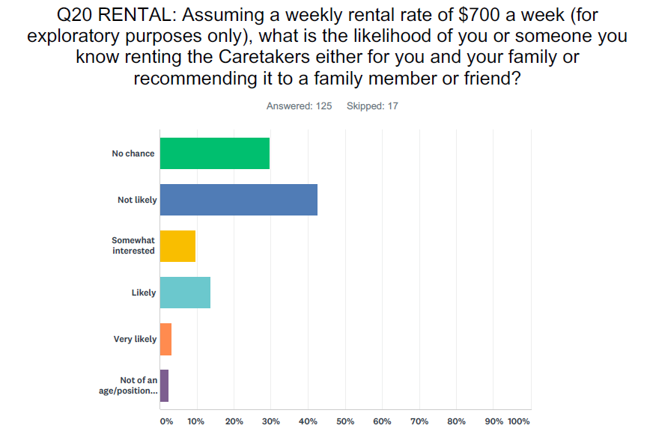
II – RENTAL OPTION
Caretaker Site Presentation July 15th, 2020

Slide 9
II – RENTAL OPTION – Con’d
Expense and Revenue Assumptions:
One Time Capital Expenses: $54,000
Health and Safety (electrical, water and septic, handrails) = $11,000
Upgrades for rental use (painting, new floor finishings, new back staircase and deck are between $36,000 and $50,000 = $40,000 (mid-point)
Annual Expenses: Between $10,800 - $14,000
These expenses are made up of ongoing maintenance and upkeep, insurance, realty tax, hydro, opening and closing, management
It could be argued that we are double accounting as some of these expenses are already carried under caretaker expenses
Annual Revenue Assumptions: Between $4,500 - $10,000
Assumes 6 weeks in year 1, 9 weeks plus some off season weekends in year 2 and thereafter @ $750 - $1,000 per week.
Caretaker Site Presentation July 15th, 2020

Slide 10
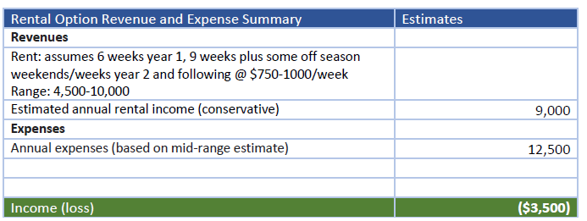
II – RENTAL OPTION con’d
The summary above does not include the upfront capital costs
Even if we assume $3,000 in annual expenses and therefore $6,000 in annual income it would take nine years to exceed the upfront capital costs
Significant risks include irresponsible renters, annual or capital expenses exceeding estimates, rental demand less than expected.
Caretaker Site Presentation July 15th, 2020

Slide 11
II - RENTAL OPTION con’d
PROS
Club retains building for possible future needs or to sell off eventually
Adds more rental capacity to the community (including overflow for weekend guests)
Potential renters could include scientific, environmental, and artistic groups
Regatta Party site is retained for club use
CONS
Both revenue and expense projections are very difficult to estimate
Given age and current condition of cottage, future capital costs and maintenance are inevitable
Membership survey results suggested demand for rental was modest
Renting is very management intensive and creates more work for the Madawaska Club Board
Caretaker Site Presentation July 15th, 2020

Slide 12
III - CONSERVATION OPTION
This option requires the demolition of some, if not all, of the existing buildings. For example, the work shop and store could be kept for club storage purposes.
This option also depends on the scale of the demolition. For example, the main and second floors of the cottage could be demolished and the foundation of the cottage be retained for future use.
Note: Expenses calculated as mid-point of estimates. The expenses above are based on complete demolition and disposal of entire cottage.
Caretaker Site Presentation July 15th, 2020

Slide 13
III - CONSERVATION OPTION con’d
PROS
The land is not lost and is there to meet the needs of future generations
The land is available for the Regatta Party complete with a hydro connection
Retaining the foundation and demolishing the top two floors could offer some flexibility in terms of future use for the community
The Club would still have the property connecting to the Club Trails
CONS
The costs of the demolition and disposal are significant
The loss of income to the club that would result should the membership opt for the sale or rental of the property.
Caretaker Site Presentation July 15th, 2020

Slide 14
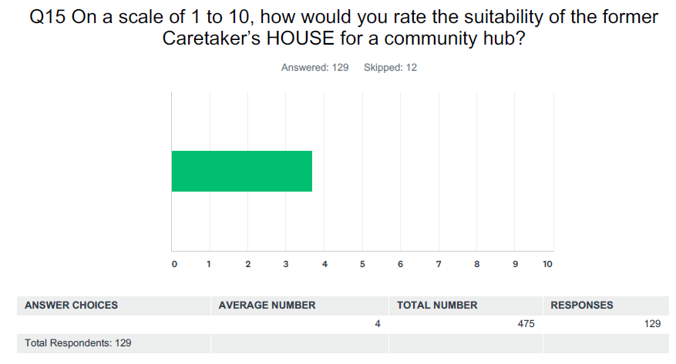
IV – CARETAKER HOUSE AS A FUTURE HUB ALTERNATIVE
Survey respondents rated the suitability of the Cottage as a community hub as a 3.7 out of 10 while rating the site itself as 5.2 out of 10
The Main Dock was rated higher at 7.3 out of 10 as a community hub
Caretaker Site Presentation July 15th, 2020

Slide 15
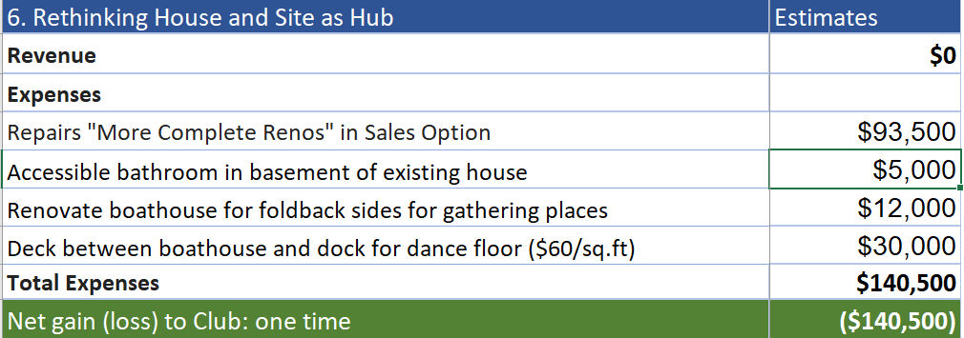
IV – CARETAKER HOUSE AS A FUTURE HUB ALTERNATIVE con’d
Further investigation is required to ascertain whether the surveying/zoning or Official Plan amendments would be required
The scope and costs of which are presumed to be much less than the Sales Option
Caretaker Site Presentation July 15th, 2020

Slide 16
IV – CARETAKER HOUSE AS A FUTURE HUB ALTERNATIVE con’d
PROS
Retaining and improving the existing Regatta Party site (i.e. moving the party out of the back area)
Existing hydro power on-site and cooking facilities at the house
Dockage, and capacity to expand dockage
Allows the site to function as an “environmental centre” with access to trails
A sliding scale of costs, and improvements could happen over time
CONS
The majority of those consulted do not favour the house and site as a hub
The site will have to be rezoned if it is to become a community centre
Safety measures and washroom facilities will have to be built
Limited views and less wind on still days and nights – perceived as “buggy”
The ROI is less as an investment elsewhere
Increased activity in the Bay will impact adjacent neighbours
Caretaker Site Presentation July 15th, 2020

Slide 17
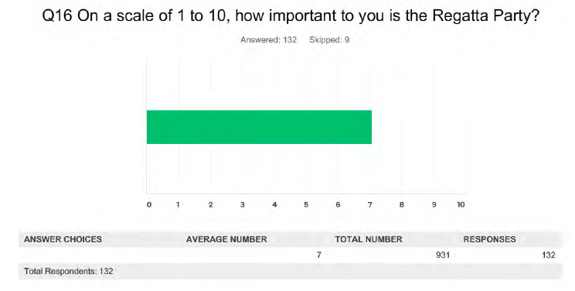
IV – MAIN DOCK AS A FUTURE HUB ALTERNATIVE
Survey respondents rated the Regatta Party as a 7 out of 10 in importance
Holding the party at the Caretaker’s Site is not as important, with a ranking of 5 out of 10
Caretaker Site Presentation July 15th, 2020

Slide 18
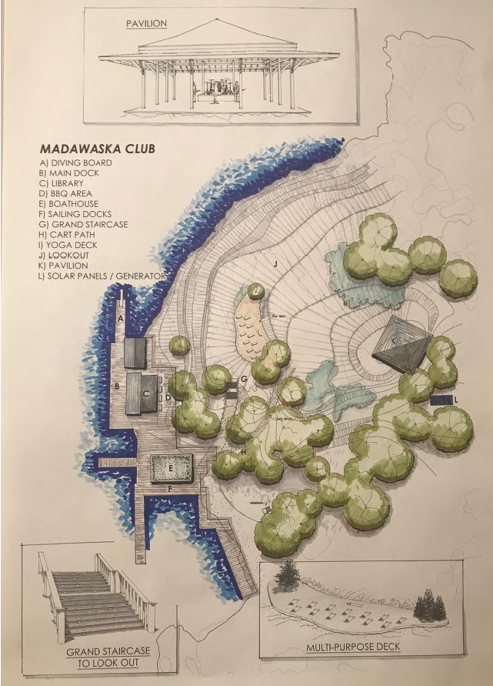
IV – MAIN DOCK AS A FUTURE HUB ALTERNATIVE con’d
The Main Dock is the iconic and historical centre of Go Home Bay
Has substantial infrastructure in place with dockage for small to medium sized gatherings and an accessible washroom
Several existing buildings include the Post Office, Library, and Boathouse
Has substantial land surrounding it: the “Lookout” that has potential for unobtrusive development
Challenges are centred around capacity: flat area size in general, dockage capacity, seating capacity, seating/deck space, cooking capacity (for the regatta), no hydro or running water
(Left) This is a concept designed by Jim Ballantyne showing a potential development of the Lookout which includes Main Dock expansion, a staircase, a pavilion and a multi-purpose deck
Caretaker Site Presentation July 15th, 2020

Slide 19
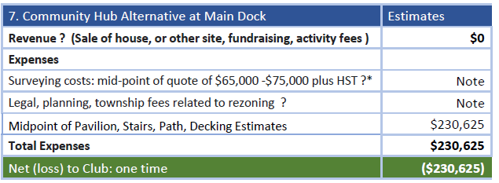
IV – MAIN DOCK AS A FUTURE HUB ALTERNATIVE
Further investigation is required to ascertain whether the surveying/zoning or Official Plan amendments would be required
The scope and costs of which are presumed to be much less than the Sales Option
Possible revenue sources include sale of Caretaker Cottage, other site(s) owned by Club, or alternative fundraising programs
Caretaker Site Presentation July 15th, 2020

Slide 20
IV – MAIN DOCK AS A FUTURE HUB ALTERNATIVE con’d
PROS
Potential to expand activities and programming offered by the Club
Potential to develop program models similar to the sailing program based on program fees that allow for hiring of paid staff
Concentrates Club infrastructure requiring on-going maintenance in one location
Excellent view and good sized area to accommodate larger gatherings
CONS
Significant capital costs; however, these could be offset by sale of Caretaker House or other undeveloped cottage sites owned by the Club
Any building permit inspections could trigger further investment into washroom facilities
Increased activity at Main Dock will impact adjacent neighbours
Caretaker Site Presentation July 15th, 2020

Slide 21
TASK FORCE CONCLUSIONS
The options preferred by the community are:
To sever and sell the house (perhaps as-is)
Demolish the building and retain the site as a community asset
Maintaining the buildings for community use, including rental, is generally seen as too resource intensive for the Club to finance and manage
Irrespective of which option is selected, there is an overwhelming desire to have a community hub which prompted the committee to include a conceptual proposal for the main dock
The rental option does preserve the Club’s capacity for a future caretaker, locally-based contractor and/or artists/scientists in residence
Caretaker Site Presentation July 15th, 2020

Slide 22
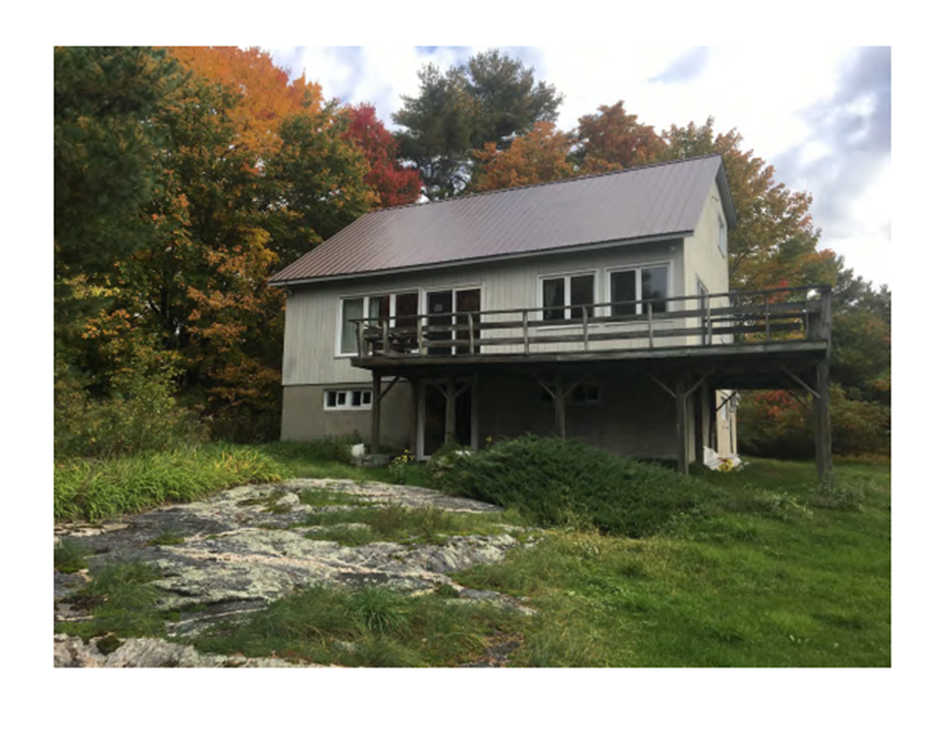
End of Formal Presentation
Caretaker Site Presentation July 15th, 2020

